Slide 1
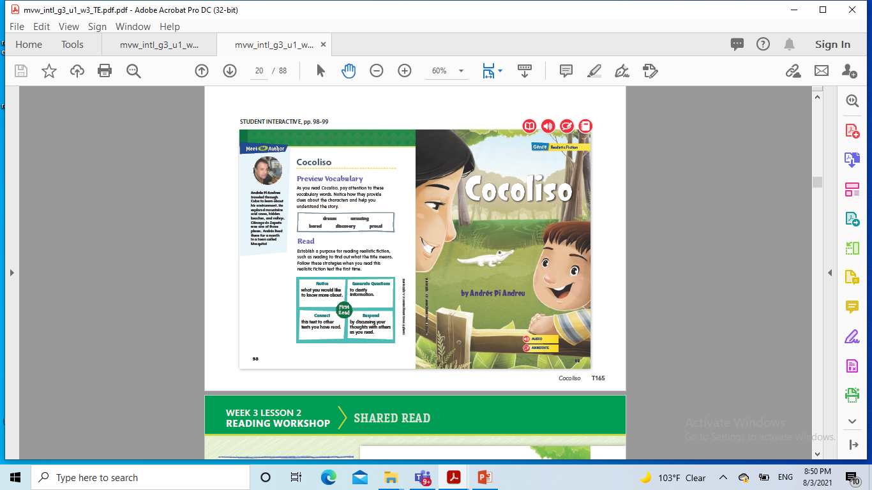
Cocoliso
Grammar

Slide 2
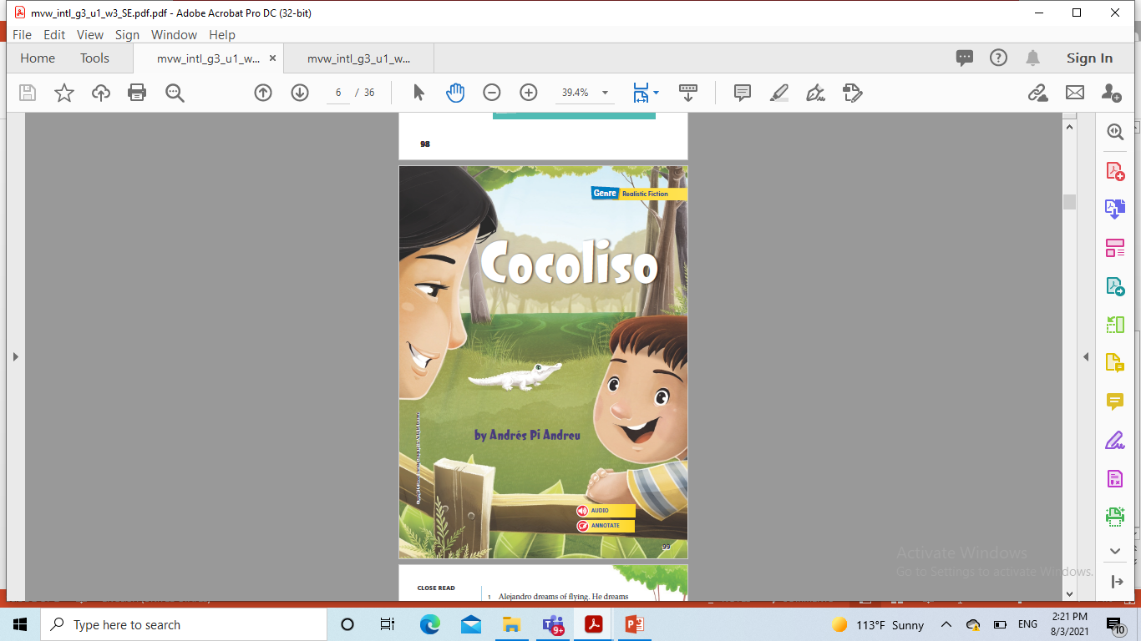

Slide 3
Genre Realistic fiction
Realistic fiction is a made-up story that could possibly happen in real life. It may include imaginary characters who act like real people
in real situations.
The characters in realistic fiction may be
• Major characters: the main character and other characters who are important to the plot
• Minor characters: characters who do not play an essential role in the plot events
Characters may narrate as a character within the story (first-person point of view) or narrate as an observer (third-person point of view).

Slide 4
Weekly Question
How can an environment affect
lives and relationships?

Slide 5
Language & Conventions Compound Sentences
A compound sentence is made up of two simple sentences and a comma with a coordinating conjunction (and, but, or or).
To form a compound sentence, follow these steps:
Join simple sentences that make sense together.
Add a comma before the coordinating conjunction.
Use and to add an additional thought, but to add a contrasting idea, and or to add another choice.
Make sure there is correct subject-verb agreement

Slide 6
A conjunction is a word that connects words or groups of words.
• To add information, use the conjunction and. To show a choice, use the
conjunction or. To show a difference, use the conjunction but.
James went to the park and a ball game.
James had never been to New York City, but he liked it.
James could stay in the city or go back home.
• You can use a conjunction to combine two sentences into a compound
sentence. Add a comma before the conjunction in a compound sentence.
James went to a ball game. Then he went home.
James went to a ball game, and then he went home.

Slide 7

Video on compound sentences

Slide 8
E.g My friend and I play soccer. We haven’t played on a team yet.
Explain to students that these sentences can make sense together.
Put the word but between them and explain how it unites the sentences’ contrasting ideas.
My friend and I play soccer,but We haven’t played on a team yet.

Slide 9
Example compound sentences
The cat jumped out of the basket. The dog chased her.
The cat jumped out of the basket, and the dog chased her. Make sure you see the comma before and.

Slide 10
Compound sentences
Compound sentences can be made by joining three words together
And , but, or
And- gives information
But- gives reason
Or- gives a choice

Slide 11
Grammar: Compound Sentences
I wanted to buy everything, but I clutched my coins tightly in my pocket.
The sentence is a compound sentence.
Two simple sentences have been combined with a comma and the word but.

Slide 12
Grammar: Compound Sentences
A simple sentence has one subject and one predicate.
A compound sentence contains two simple sentences joined by a comma and a word such as and, but, or or.

Slide 13
Grammar: Compound Sentences
Simple Sentence: The boy helped his mother.
Simple Sentence: His mother bought him a bicycle.
Compound Sentence: The boy helped his mother, and his mother bought him a bicycle.

Slide 14
Grammar: Compound Sentences
The two parts of a compound sentence have ideas that make sense together.
A comma goes after the first sentences before the word and, but, or or.

Slide 15
Grammar: Compound Sentences Tell if each sentence is a simple sentence or a compound sentence.
The family had a farm.
simple sentence
The boy planted beans, and his mom planted pumpkins.
compound sentence
The family ate bananas and spinach.
simple sentence

Slide 16
Grammar: Compound Sentences Tell if each sentence is a simple sentence or a compound sentence.
The spinach tasted good, but the bananas tasted better.
compound sentence
The boy picked the crops, and his father sold them.
compound sentence

Slide 17
Grammar: Compound Sentences Add a comma where needed.
A wheelbarrow carries crops but it is hard to push.
A wheelbarrow carries crops, but it is hard to push.
You can pick peas or you can gather sweet potatoes.
You can pick peas, or you can gather sweet potatoes.

Slide 18
Grammar: Compound Sentences Add a comma where needed.
It rains in spring and the crops grow quickly.
It rains in spring, and the crops grow quickly.
Coffee grows on trees and pumpkins grow on vines.
Coffee grows on trees, and pumpkins grow on vines.

Slide 19
Grammar: Compound Sentences Add a comma where needed.
Farming is hard work but the family enjoys it.
Farming is hard work, but the family enjoys it.

Slide 20
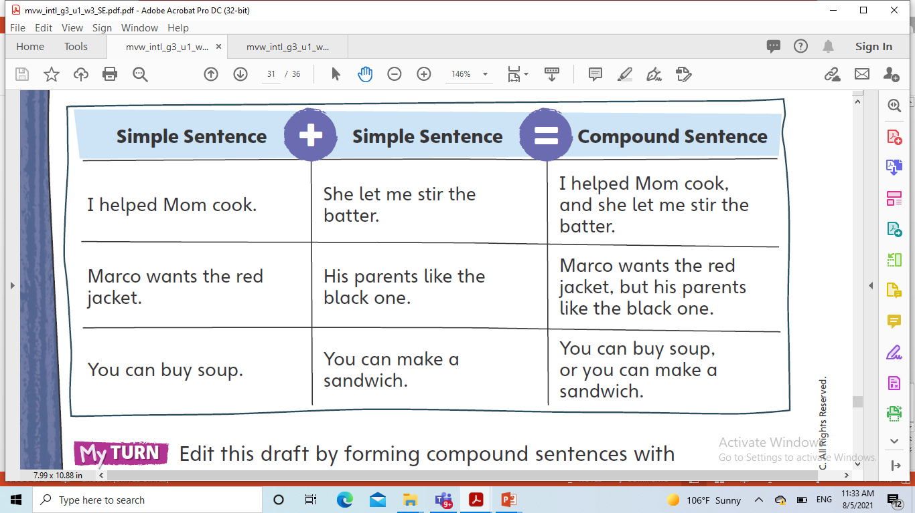
Pg.124

Slide 21
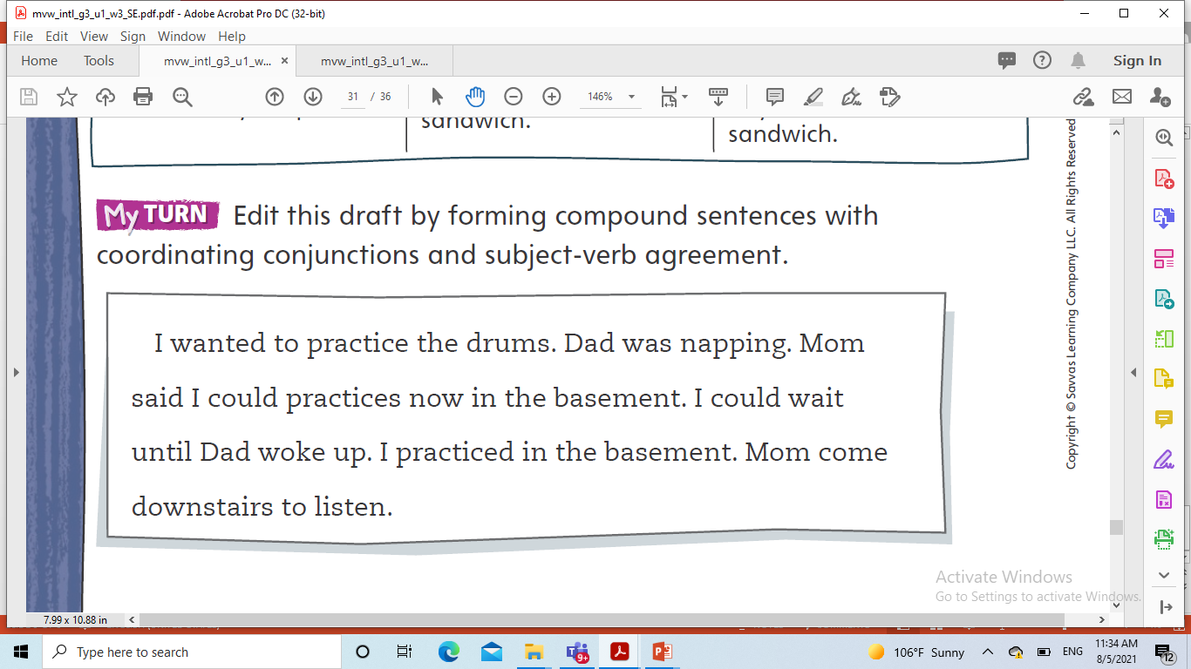
Pg.124

Slide 22
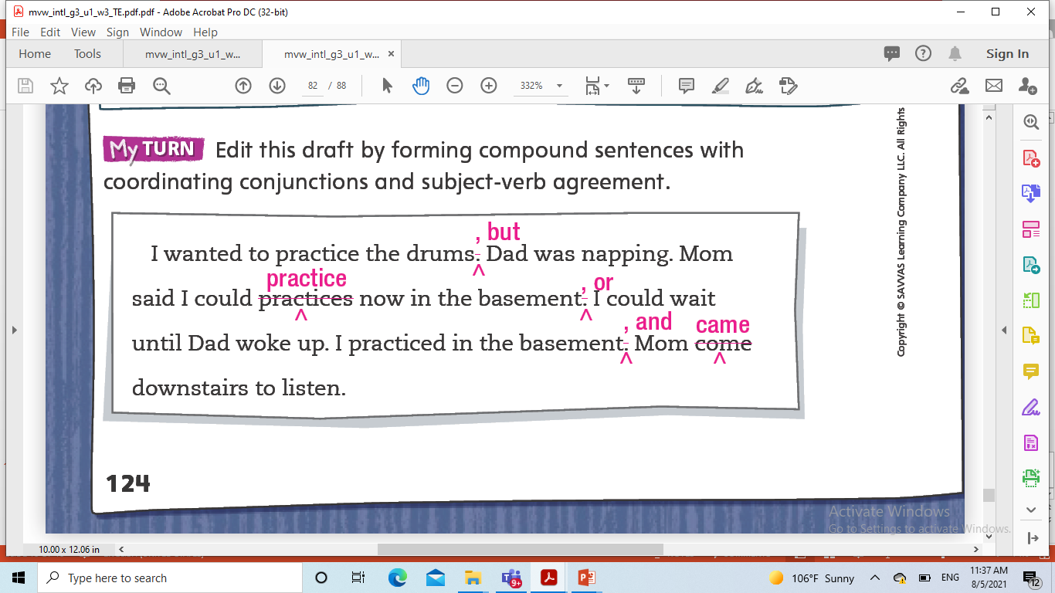

Slide 23
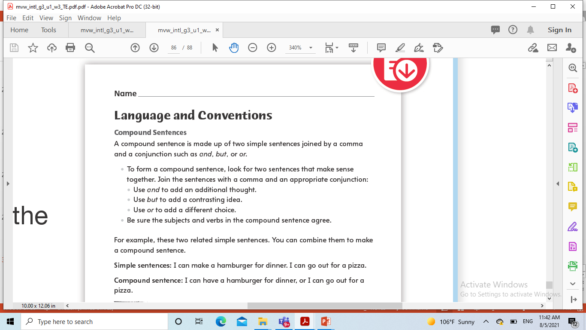
Resource center

Slide 24
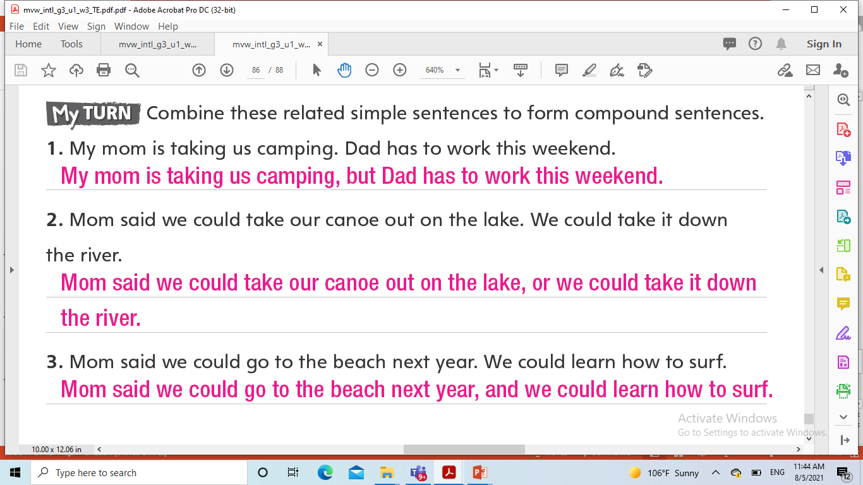
Resource center

