Slide 1

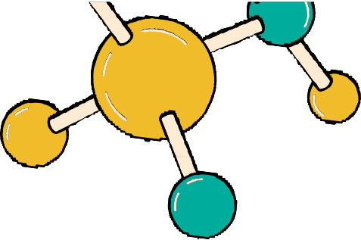
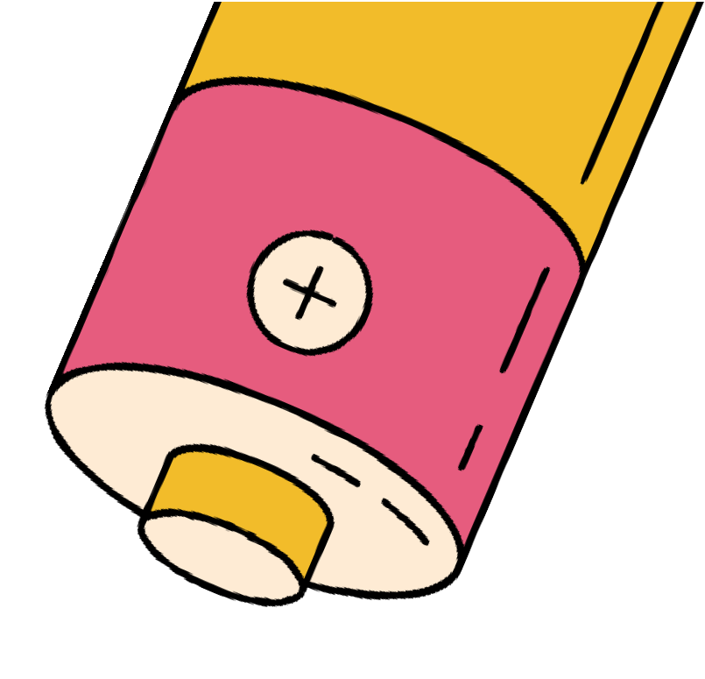





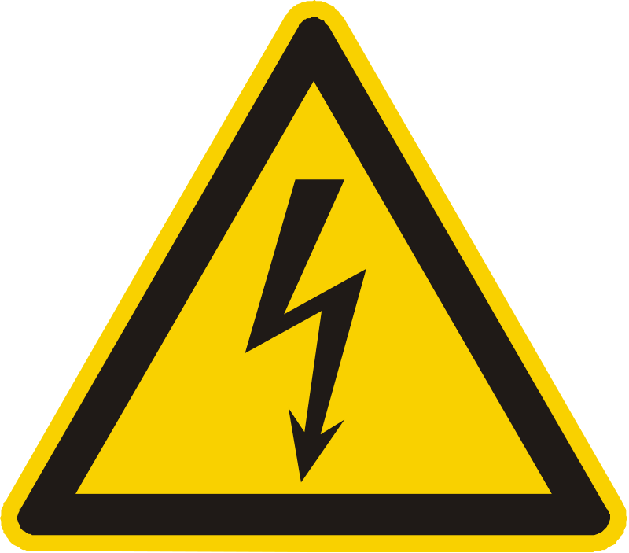




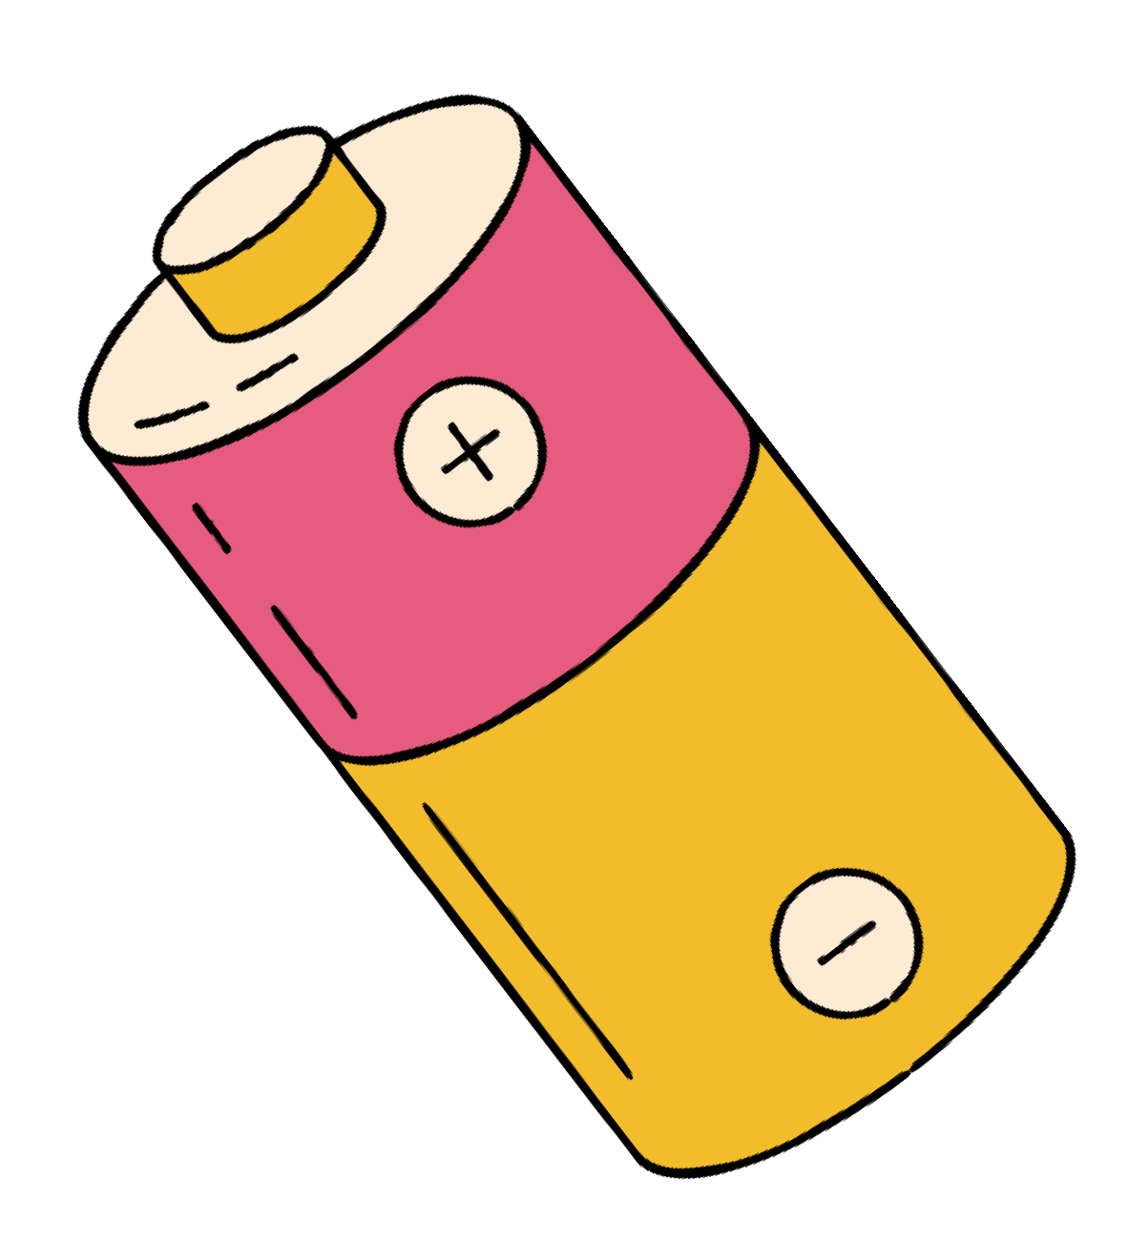










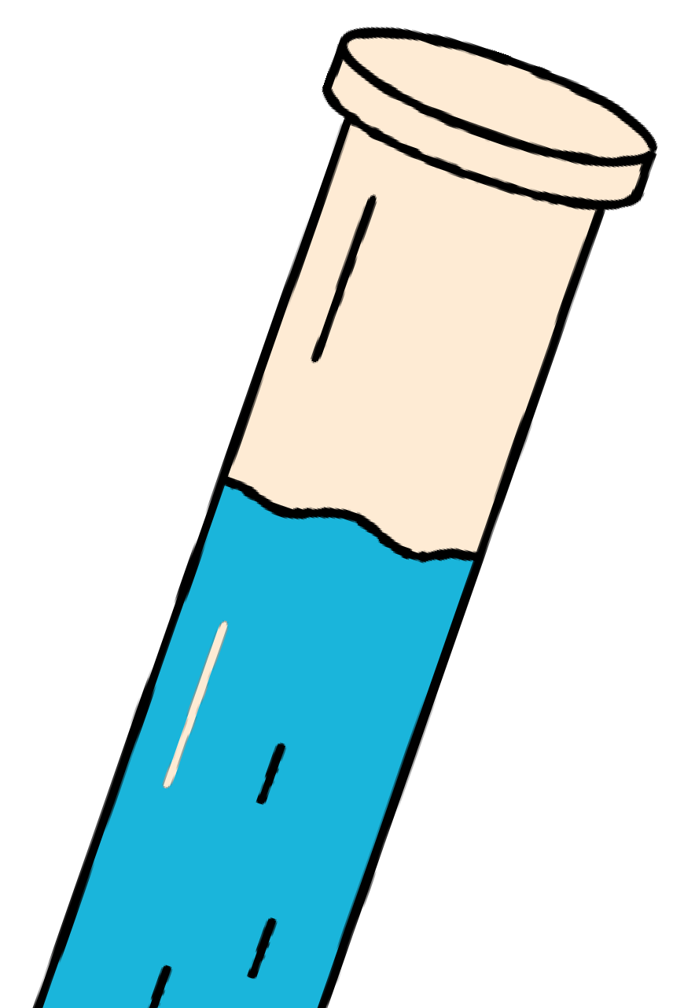



Slide 2












We learned about Force as A contact force and Non-contact Force.
We knew that Electricity is one of the
Non-contact forces that act at a distance.
But What the meaning of Electricity?
Can we see the Electricity in Real Life?
And How we can make an electric circuit
LET'S FIGURE IT OUT TOGETHER

Slide 3

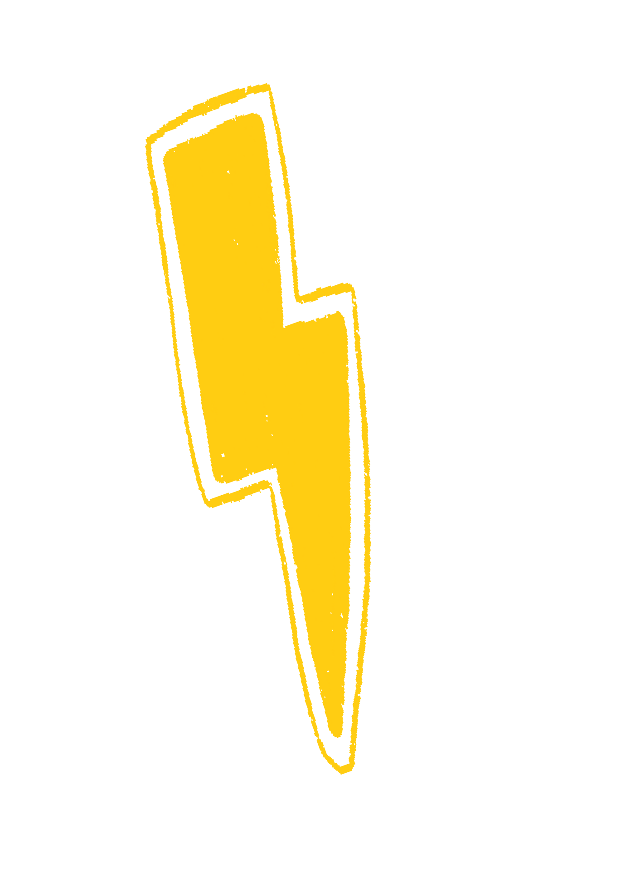
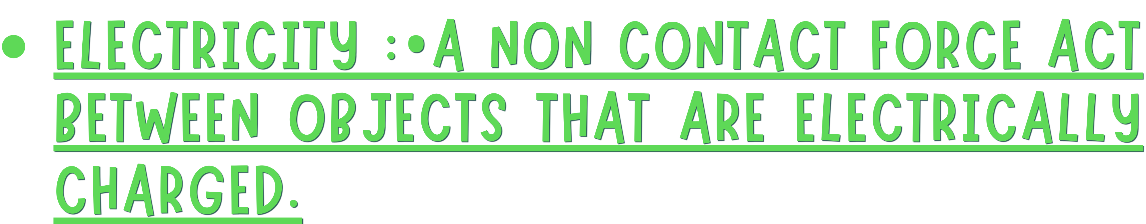



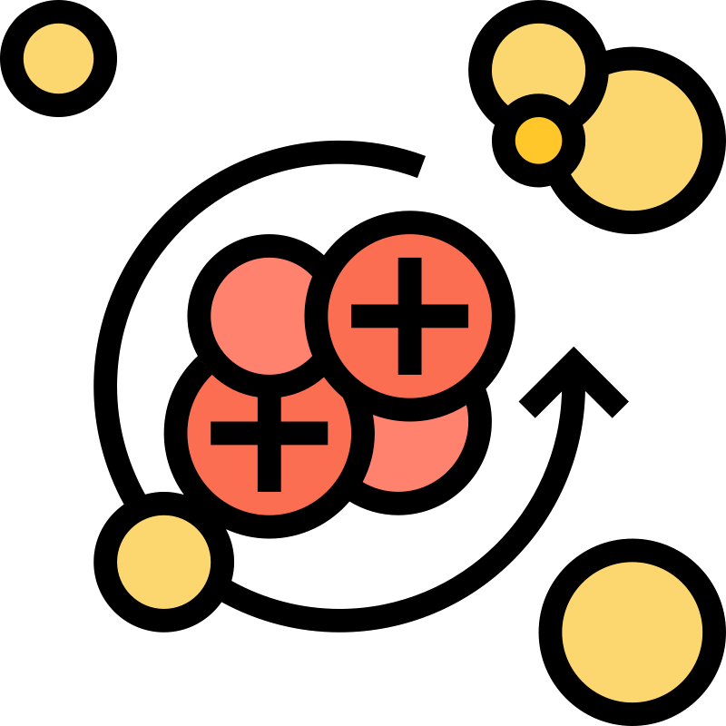
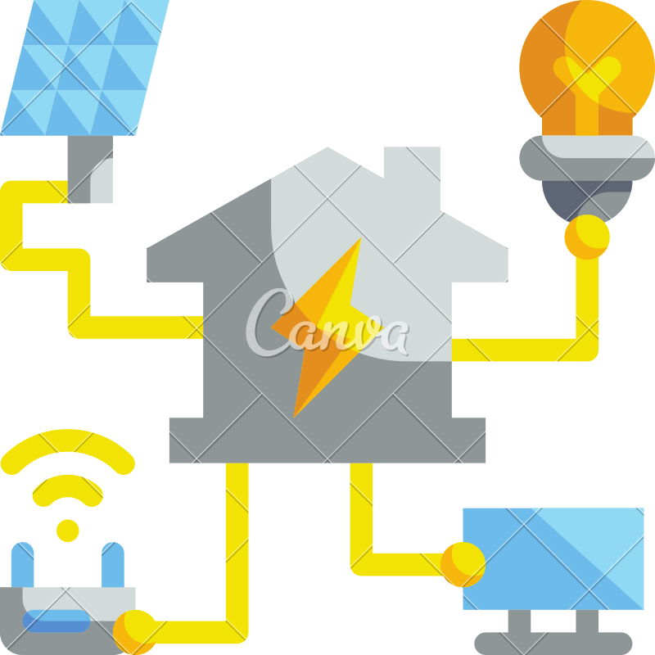



ElecTRiciTY in NaTURe
Lightning is basically static electricity caused by huge concentrations of raindrops rubbing against each other high up in the sky.
The electricity of lightning can travel far from the storm. It can strike people and other objects 15 km or more away from rain is falling. So you Should be careful when you see a flash of distant lightning.
page 56

Slide 4

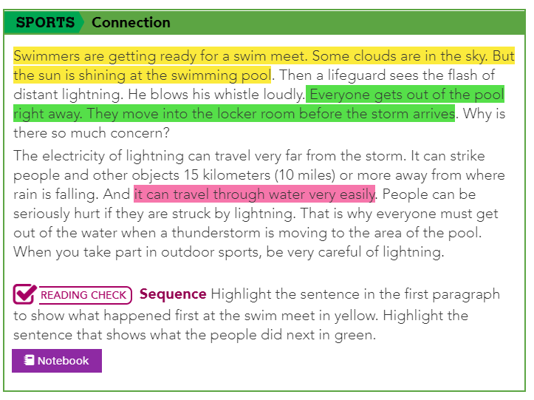
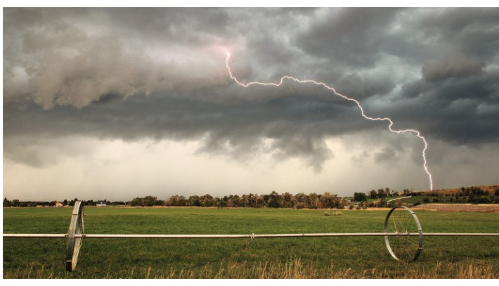
BOOK PAGE

Slide 5
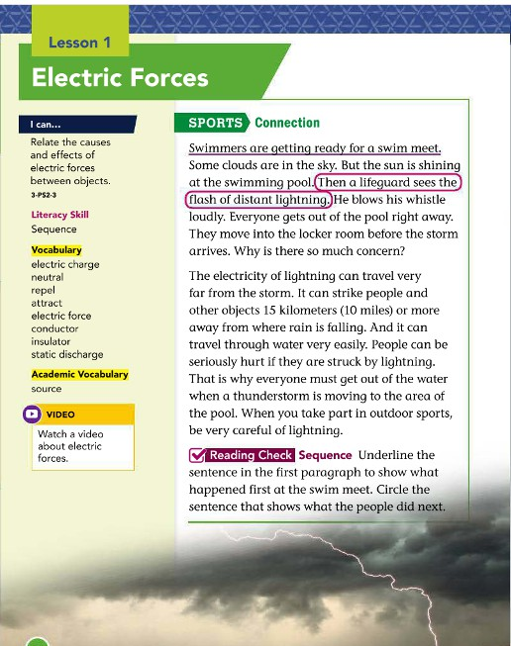
BOOK KEY ANSWER

Slide 6






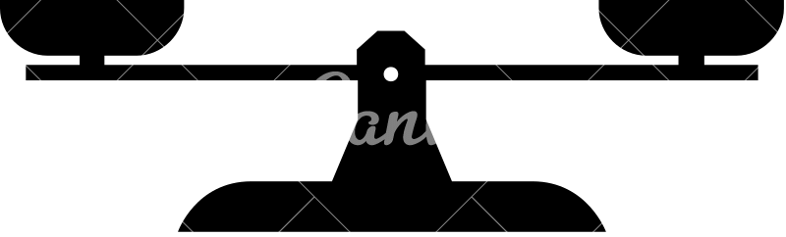
01
page 58
All matter is made of small particles. These
Negative
particles can have electric charges.
Electric charges : When matter has an overall of positive charge or negative charge
Positive
Some charges are Positive (+), Some are Negative (-) , and
++++
Neutral
----
some have the same number of positive charges and negative charges its called Neutral.
The matter that is Neutral or we can say the it has No electric charge.

Slide 7




01 EXamPle
Three Balloons, each balloon have electric charges, what is the overall charge for the three balloons?
+ + -
+ + -
+ + -
- - -
+ - +
- - +
+ - -
+ +
+ + -

Slide 8



01 EXamPle S0lUTi0n
Three Balloons, each balloon have electric charges, what is the overall charge for the three balloons?
+ + -
+ + -
+ + -
- - -
+ - +
- - +
+ - -
+ +
+ + -
Positive
Negative
Neutral

Slide 9





02 Atrraction :Refers to the force between two different charged objects (
Positive and negative attract to each other).
Attract
Your paragraph text
03 Repulsion
refers to a force between two or more similar or like charges.
Repel
Repel
page 59

Slide 10
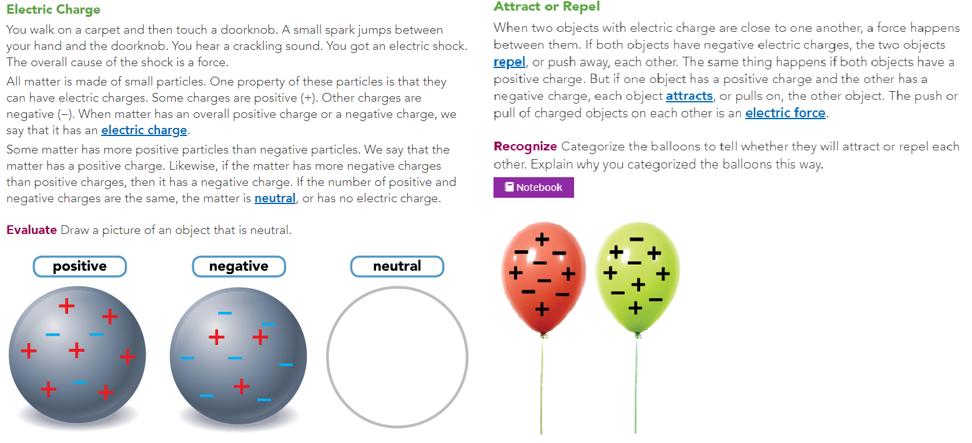
BOOK PAGE

Slide 11
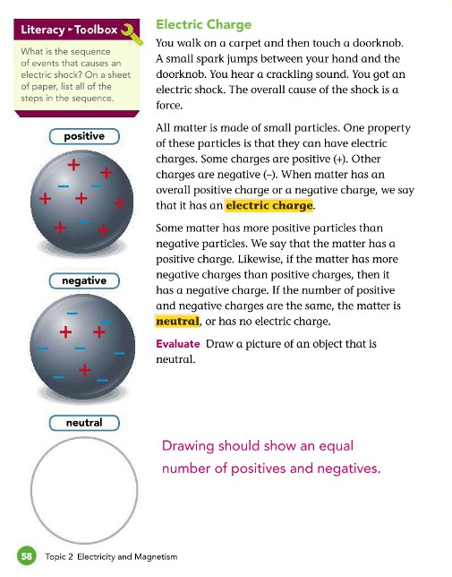
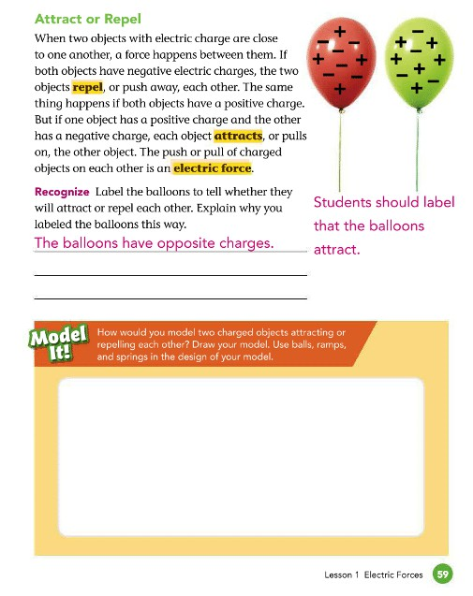
BOOK KEY ANSWER

Slide 12



02 ExamPle
Draw arrows that shows the repulsion or attraction between the electric charges below:
+ +
-
-
-
+
+++
--
---
-

Slide 13




02 ExamPle
Draw arrows that shows the repulsion or attraction between the electric charges below:
+ +
-
-
-
+
+++
--
---
-

Slide 14
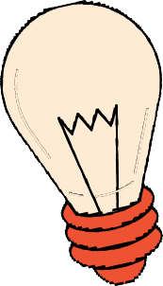


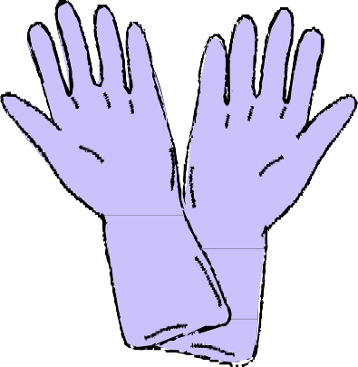
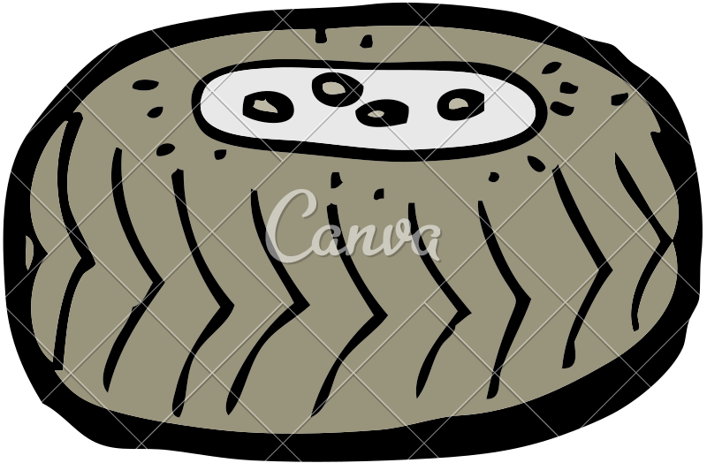
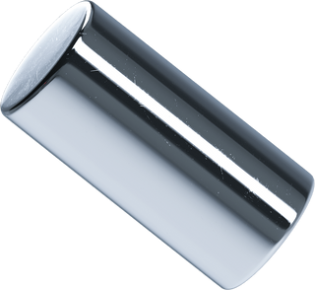

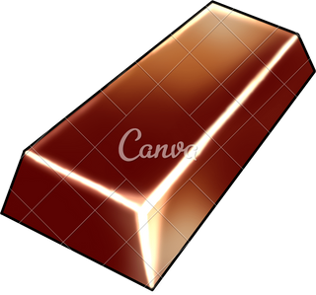
⁰⁴ HOW DO ELECTRIC CHARGES MOVE ? page 60+61
ElecTRic cHaRgeS mOve inSide ObJecTS. THe mOvemenT Of THeSe PaRTicleS dePendS On THe kind Of maTeRial THe ObJecT made Of.
Conductors: Materials that allow the electric charges to move easily.
Insulator: Materials that electric charges cannot move easily.

Slide 15

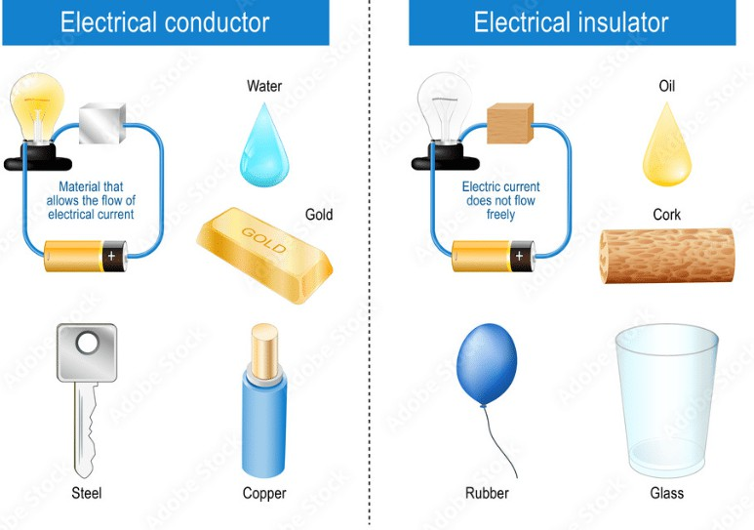
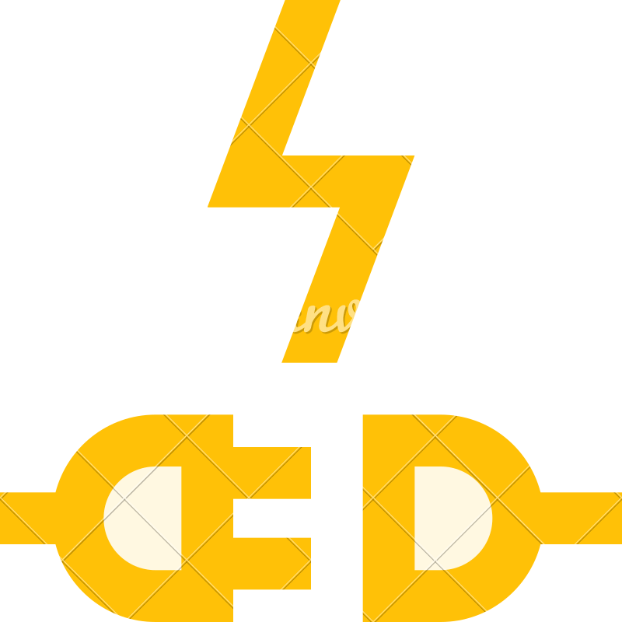


Slide 16

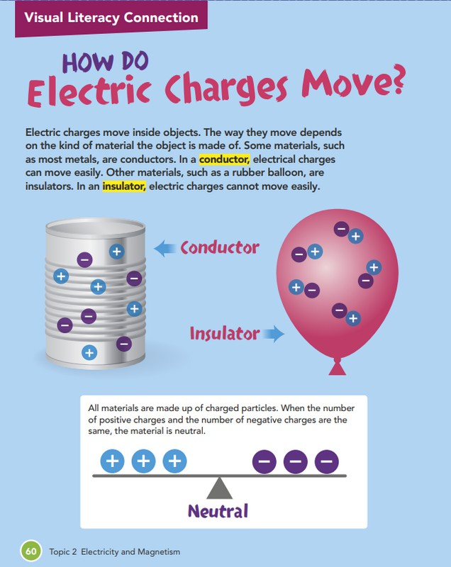
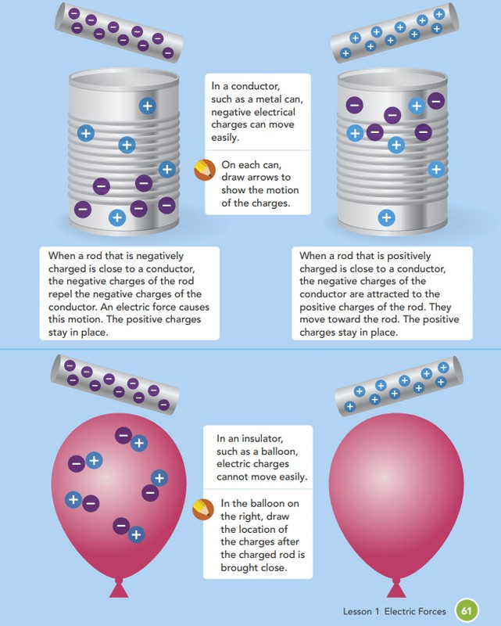
BOOK PAGE

Slide 17

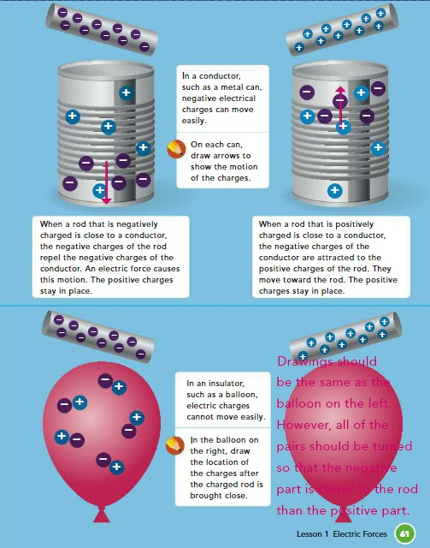
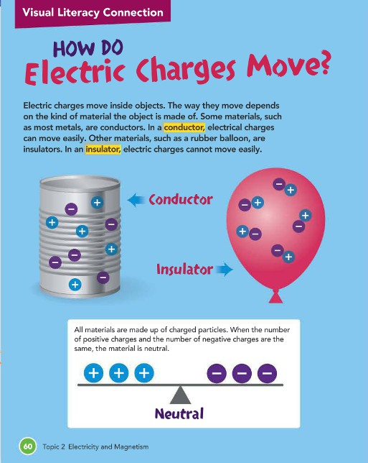
BOOK KEY ANSWER

Slide 18



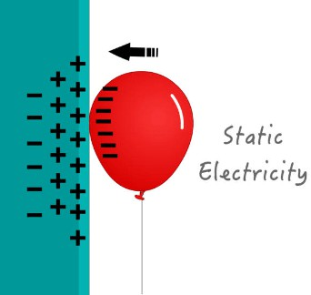
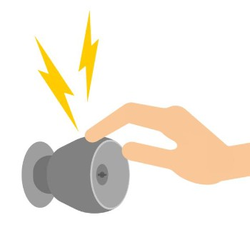
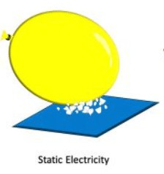
05 Static Electricity
page 62
IIss tthhee ttrraannssffeerr ooff ppaarrttiicclleess tthhaatt hhaavvee aann eelleeccttrriicc cchhaarrggee bbeettweeeenn oobbjjeeccttss tthhaatt aarree nnoott ttooucchhiinngg...
EXamPleS

Slide 19

When you walk across some carpets, negatively charged particles in the carpet move to your body. Your body then has a negative charge. When your finger comes near a door knob, the electric force between you and the doorknob causes a static discharge to occur.
Another example of static electricity is Lightning strike but it is much more powerful.

Slide 20
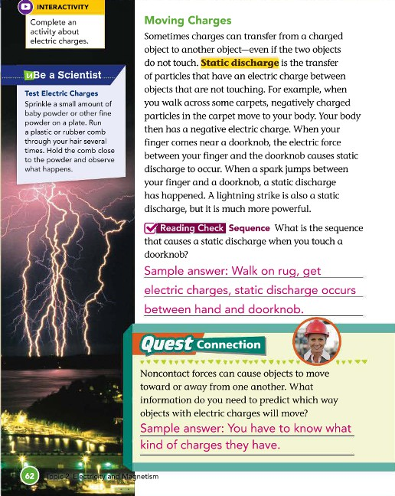
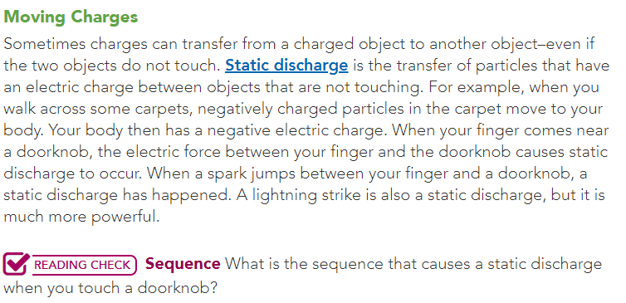
BOOK KEY ANSWER
BOOK PAGE

Slide 21




⁰⁶ Strength of Electric Force
page 63
1. THE aMOUNT OF ELECTRIC
Objects with a lot of electric charge will have a greater electric force than objects with less elecrtic charge.
CHaRGE THE OBJECTS HaVE.
2.THE DISTaNCE BETwEEN THE OBJECTS
The strength of electric force become stronger as electrically charged objects get closer to each other. If the objects are farther apart , the force is weaker.

Slide 22

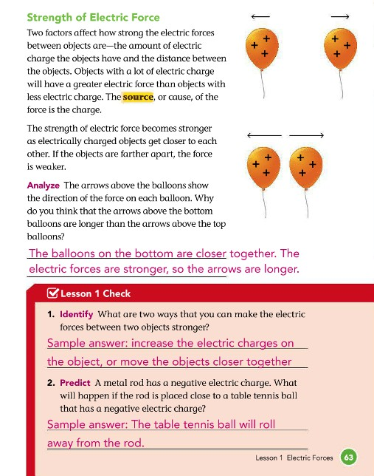
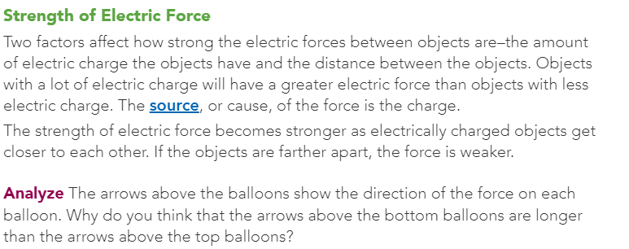

BOOK PAGE
BOOK KEY ANSWER

Slide 23








Any questions? Don't hesitate to ask for my help.

