Slide 1
Unit 2
Culture and Traditions

Slide 2
Measuring Time
2
2

Slide 3
Essential Question:
-How was time measured in the past?
Objectives:
- I can identify ways people measured time in the past.

Slide 4
Theme Vocabulary
  Decade
  Century
  Calendar

Slide 5
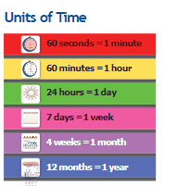
Units of Time
Time is measured in units like seconds, minutes, and hours.
There are 60 seconds in a minute, 60 minutes in an hour, 24 hours in a day, and 7 days in a week.
10 years make 1 decade, and 100 years make 1 century.
Fill in the blanks.
There are years in 1 decade and decades in 1 century.
10
10

Slide 6


Tools for Telling Time
Clocks, both with hands and digital, show the current time.
A calendar shows days, weeks, and months in a year.
Calendars help you see both past and future time.
It is Monday. Your friend invites you to a party on Saturday.
Which of these will help you to remember the party, a calendar or a clock? Why?
A calendar would help because it shows the days in the week.

Slide 7
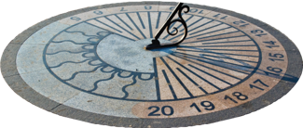
Old Tools for Telling Time
Before clocks, people used sundials during the day to tell time with the Sun's shadow.
At night, they used water clocks, which measured time as water drained.
Imagine you wanted to tell the time before clocks were invented.
Would cloudy weather cause a problem? Why or why not?
Yes, because you can’t see shadows in cloudy weather.

Slide 8
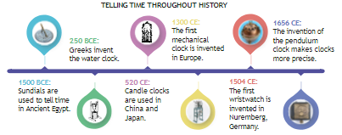
Picturing Time
Clocks show time, and calendars show the day.
A timeline shows the order of events in history with marked dates.
Timelines can be horizontal (left to right) or vertical (top to bottom).
What are some important events in your life? Create your own time line.
Choose at least two events. Remember to include the date, a description, and a drawing of each event.

Slide 9
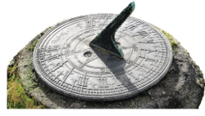
Studying the Past
Humans have a long history of telling time, with sundials and water clocks made thousands of years ago.
Museums display these ancient tools to show how time was kept and what life was like in the past.
The ancient Egyptians invented the first sundial over 3,000 years ago, showing the importance of time.

Slide 10

Tell one way your country tells time.
clocks, watches, mobile phones
Write one reason it is important for people to know what time it is.
People need to know what time it is so they know when they need to be in different places.
Write one way people told time before clocks were invented.
a sundial
What is a calendar? Describe it in one sentence.
A calendar is a tool for showing the days, weeks, and months of a year.

