Slide 1
Unit 2
Changes Over Time

Slide 2
The Empires in the Gulf
2
1

Slide 3

Essential Question:
How are we connected to the early empires that ruled in the Gulf area?
Objectives:
I can name the empires that ruled in the Gulf area and explain the effect of empires on the modern world.

Slide 4

Theme Vocabulary
Empire
Conquer
Dynasty

Slide 5
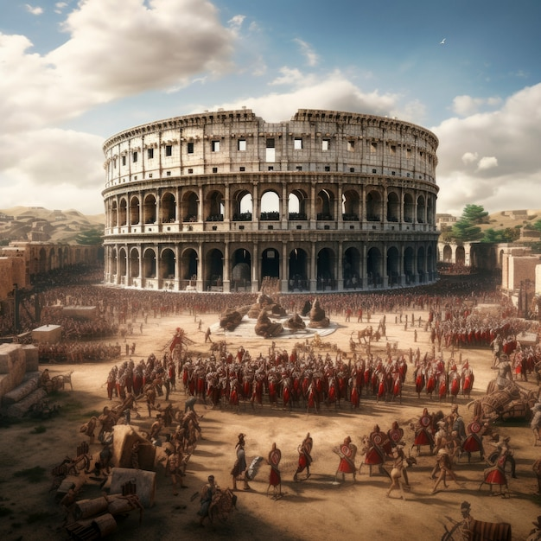
The Gulf Empires
Empires, which are countries that control lands and people outside their borders, were ruled by one person or family.
They would conquer (take by force) and impose their rules on diverse cultures, using powerful armies for resources, wealth, or power.
Gulf empires in the Middle East were known for their wealth, cultural achievements, and contributions to arts and sciences.
Studying empires reveals how different cultures lived, what they valued, and their governance.

Slide 6
Explain one way history can help you understand your country better.
History can help us understand how culture and language changed over time.

Slide 7
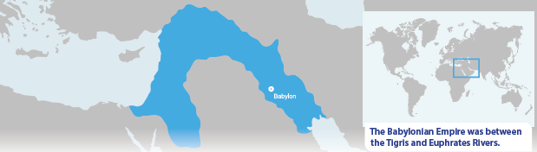
The Empires of Mesopotamia
Mesopotamia's early empires were between the Tigris and Euphrates Rivers.
The Sumerian Empire (4000-2300 BCE) developed a writing system and excelled in math and astronomy.
The Babylonian Empire (1894-1595 BCE) created the first written laws, Hammurabi’s Code, and had remarkable architecture.
The Assyrian Empire (911-609 BCE) was known for its powerful army and organized government.

Slide 8
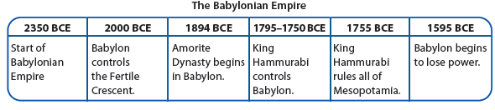
Time Lines
Time lines are tools people use to organize information. They tell the order of events that happen.
Name the world’s first set of laws.
Hammurabi’s Code

Slide 9
The Persian Empire
The Persian Empire, founded by Cyrus the Great in 550 BCE, stretched from the Mediterranean to India.
It lasted until 330 BCE and was ruled by notable kings like Darius the Great (522-486 BCE).
The Persian Empire was renowned for cultural achievements in art, architecture, government, and literature.

Slide 10
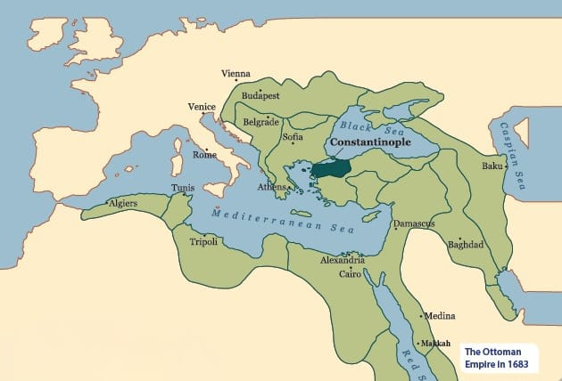
The Gunpowder Empires
The Gunpowder Empires, starting in the 1400s CE and lasting into the 1700s, included the Ottoman, Safavid, and Mughal Empires.
A dynasty is a series of rulers from the same family.
Named for their use of gunpowder weapons like rifles and cannons.
They shaped their regions and the world, leaving a legacy of buildings, cultural traditions, and technological advances.

Slide 11
How did the Gunpowder Empires affect the Gulf Area? Explain to a classmate.
The Gunpowder Empires left beautiful buildings, cultural traditions, and technological advances.

Slide 12
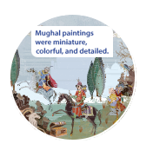
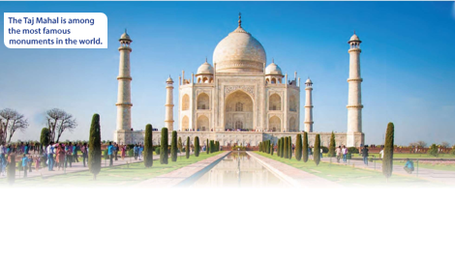
The Mughal Empire
The Mughal Empire ruled India and parts of Central Asia and the Middle East in the 16th and 17th centuries.
Mughal emperors built the Taj Mahal and supported arts and sciences.
Aurangzeb, the last Mughal ruler, ruled until 1857, with violent conquests and destruction.
Revolts against Aurangzeb weakened the dynasty.

Slide 13
The Ottoman Empire
The Ottoman Empire was the longest-lasting Gunpowder Empire, from 1299 to 1922.
It controlled much of southeastern Europe, western Asia, and northern Africa.
The Ottomans made significant contributions to art, architecture, and science.
Architect Sinan designed many beautiful buildings, including mosques and palaces that still exist today.

Slide 14
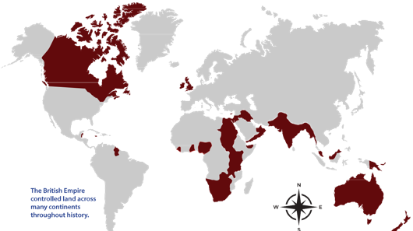
The British Empire
The British Empire, starting in 1815, ruled over five continents and became one of the largest and wealthiest empires.
By 1922, it controlled about one-fourth of the world's land and nearly 458 million people.

Slide 15
The British Empire
The empire modernized colonies, building infrastructure and boosting trade, but also had lasting negative effects on local cultures.
Former colonies like the US, India, and others in Africa and Asia gained independence, yet British influence remains in their cultures and languages.

Slide 16
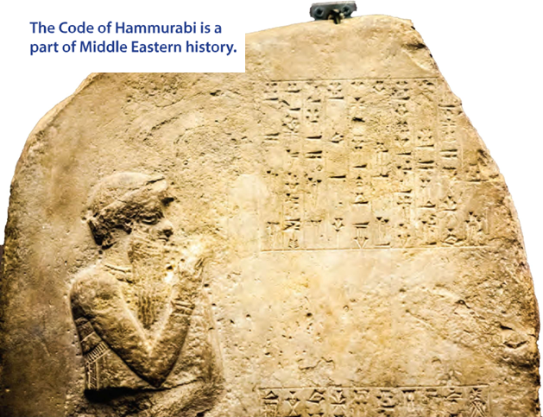
Effects of the Empires in the Middle East
Empires like Mesopotamian, British, Persian, and Ottoman have lasting impacts today.
Conquering lands caused violence, slavery, and resource loss.
Empires changed languages, traditions, and political systems but also advanced art, agriculture, technology, and trade.
Studying these empires helps understand the historical growth and changes in the Middle East and its people.

Slide 17
Checkpoint
What helped the British Empire become powerful and wealthy?
The takeover of new lands to control new economies and resources
Their strong leader who had not yet conquered many lands
No laws in their territories
The independence of the territories they ruled

Slide 18
Checkpoint
Describe one reason for the rise and fall of many empires in the Gulf area.
Empires wanted wealth and power and would fight for it. The people the empires conquered would fight back for control of their land.
Think of the name of an empire. Share with a classmate why you think that empire was better than the others.
British Empire — It introduced new technology; Babylonian Empire — It created the first written set of laws.

