Slide 1
Preposition and Prepositional Phrase

Slide 2

*in :

Slide 3
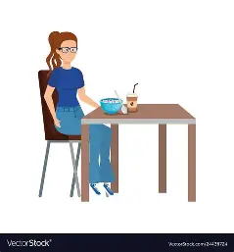
*Beside :

Slide 4
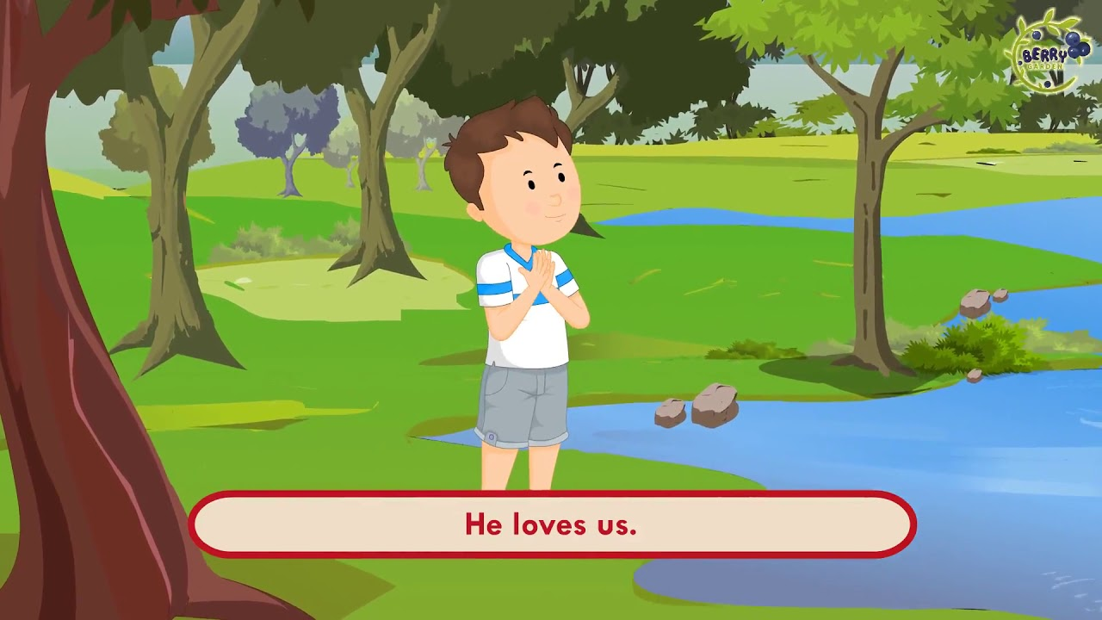
*Across :

Slide 5

*Under :

Slide 6
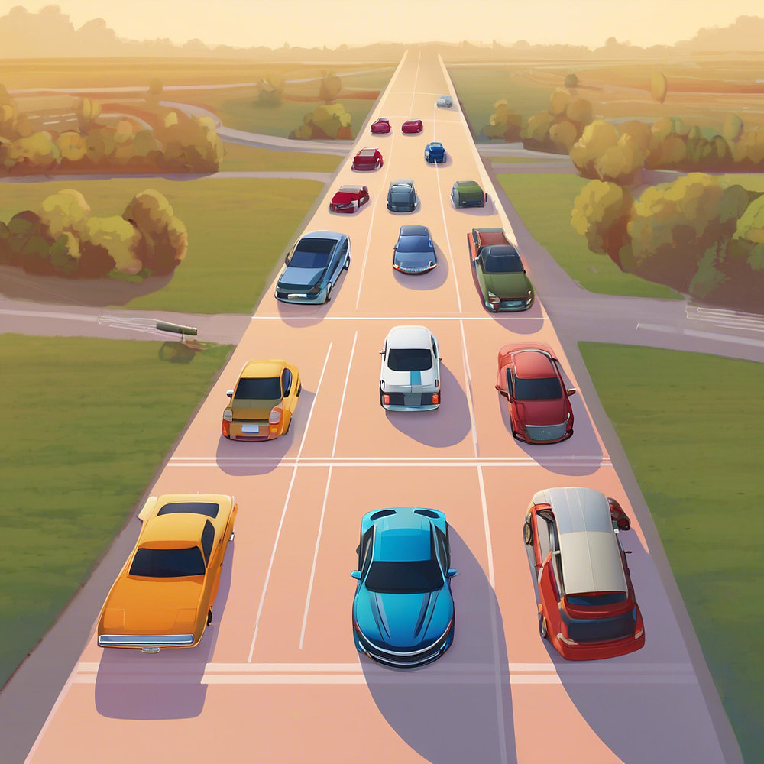
*between :

Slide 7

*Behind :

Slide 8
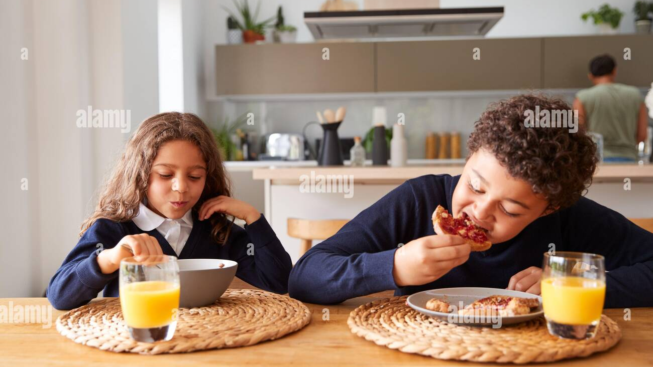
*Before :

Slide 9
*Prepositional phrase : includes the preposition and the object of the preposition ,which is a noun or pronoun .
For example : 1-The book is on the table .
On the table : is a prepositional phrase .
2- The ball rolled across the street .
Across the street : is a prepositional phrase .

