Slide 1
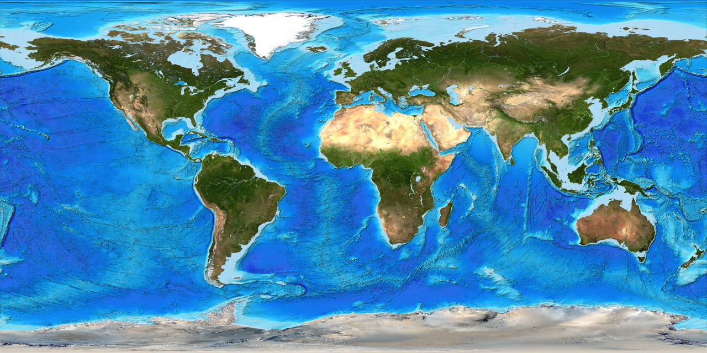
Geography and maps
This Photo by Unknown Author is licensed under CC BY-SA-NC

Slide 2
What does the word geography mean ?
The study of places and the relationships between people and their environments .
The study of the lands ,features , inhabitants , and phenomena of earth .

Slide 3
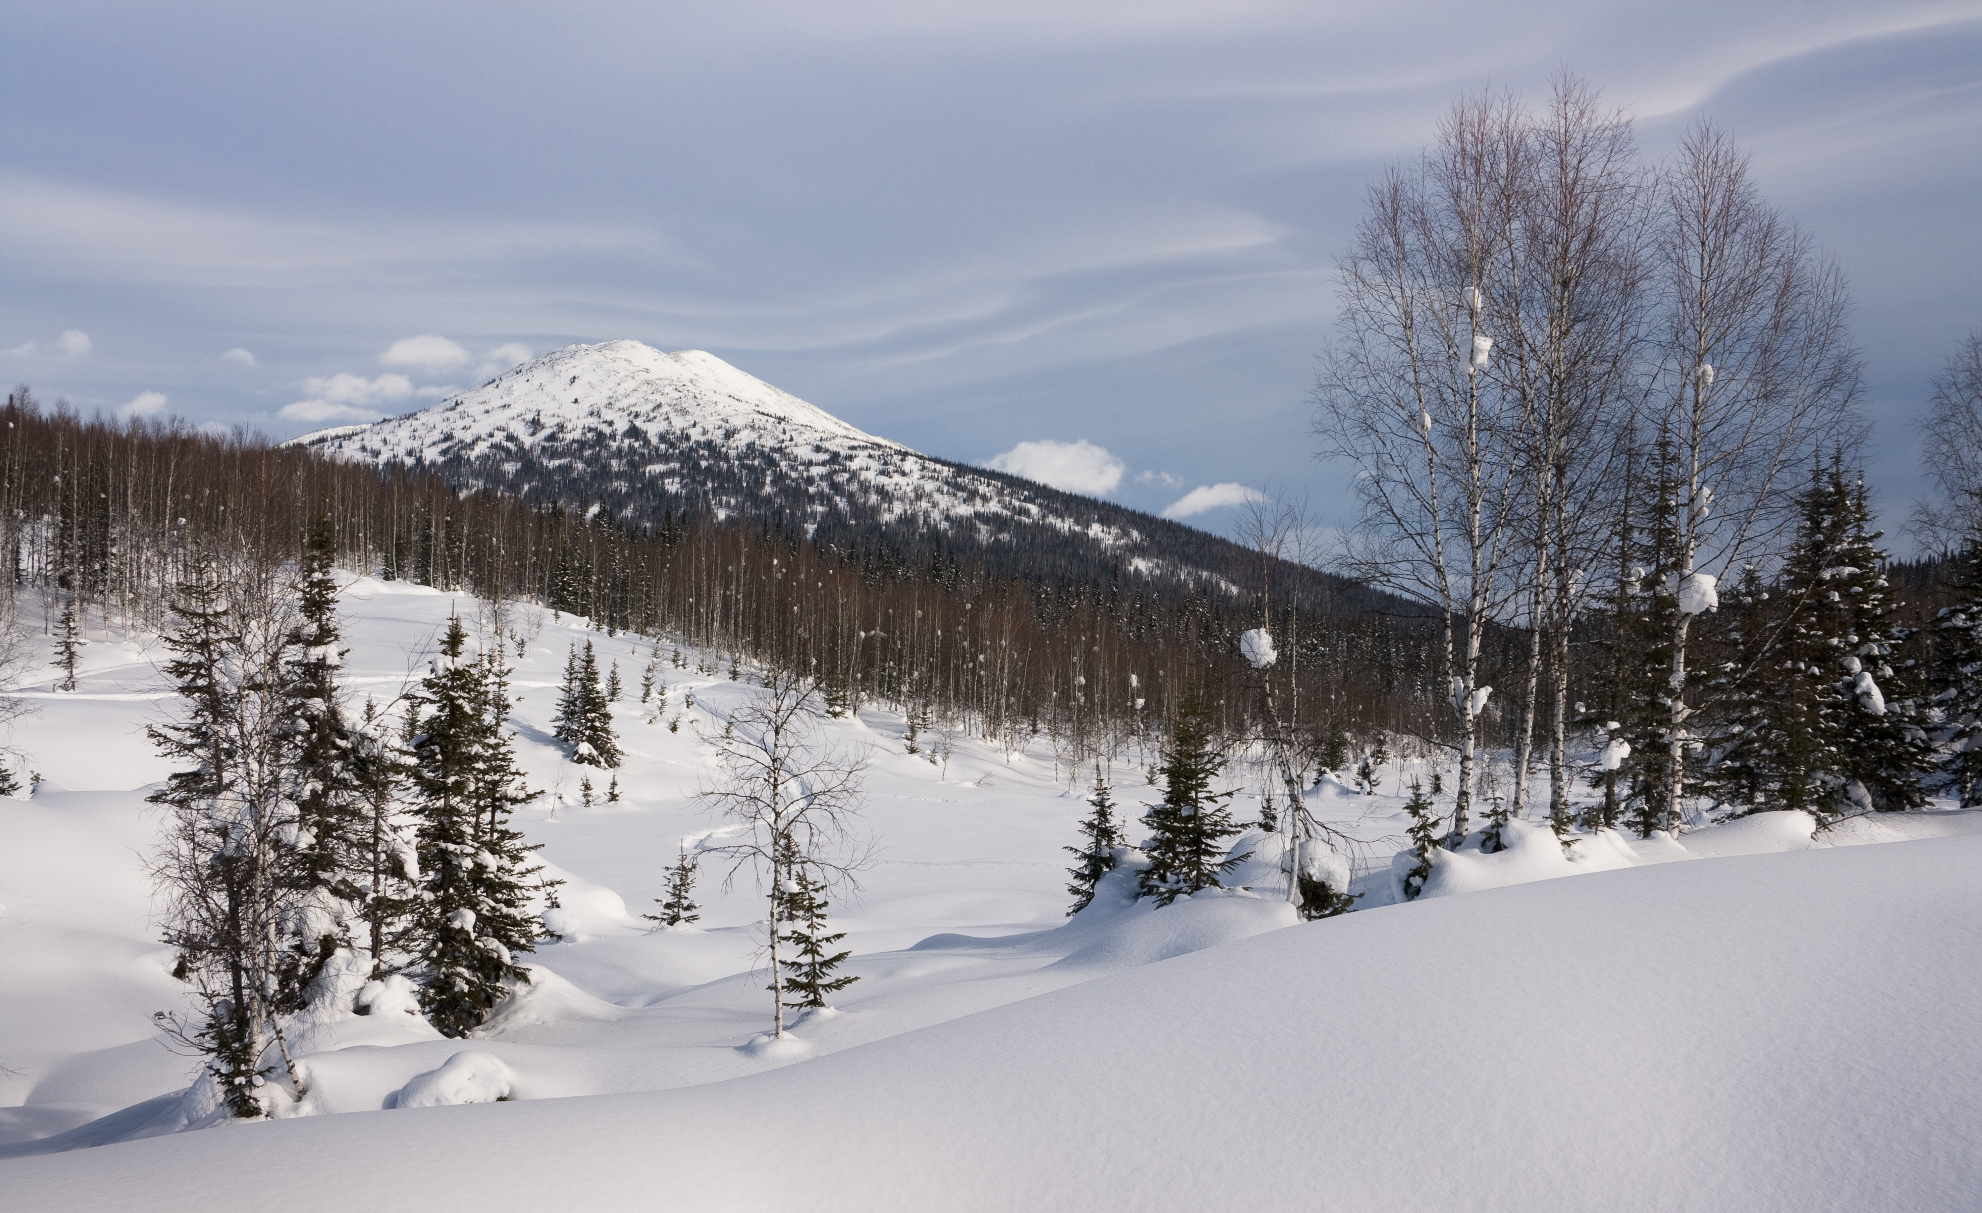
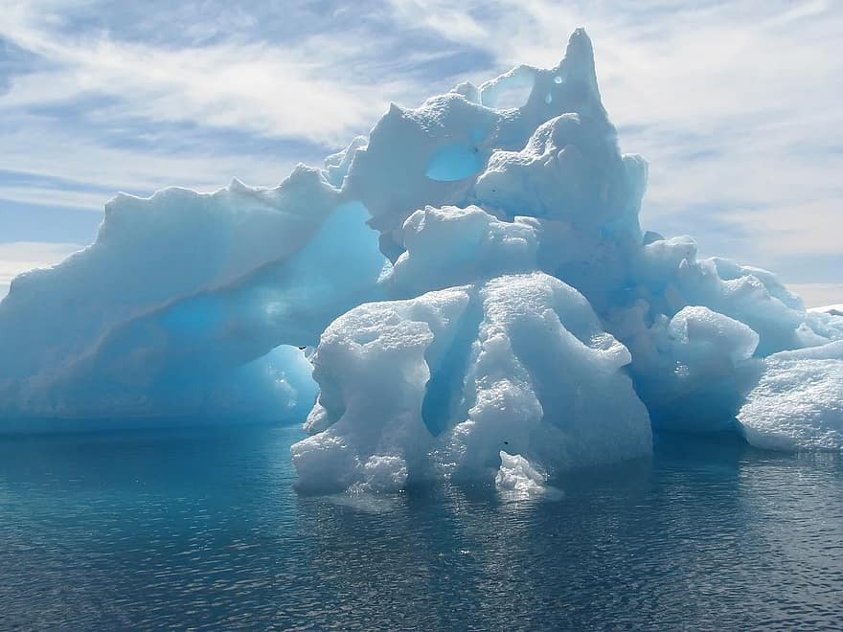
Give me an example of an environment , and how do organisms adapt to that specific area?
1- Tundra and polar environment : are found in the earth’s latitudes and are characterized by cold temperatures and a limited growing season.

Slide 4
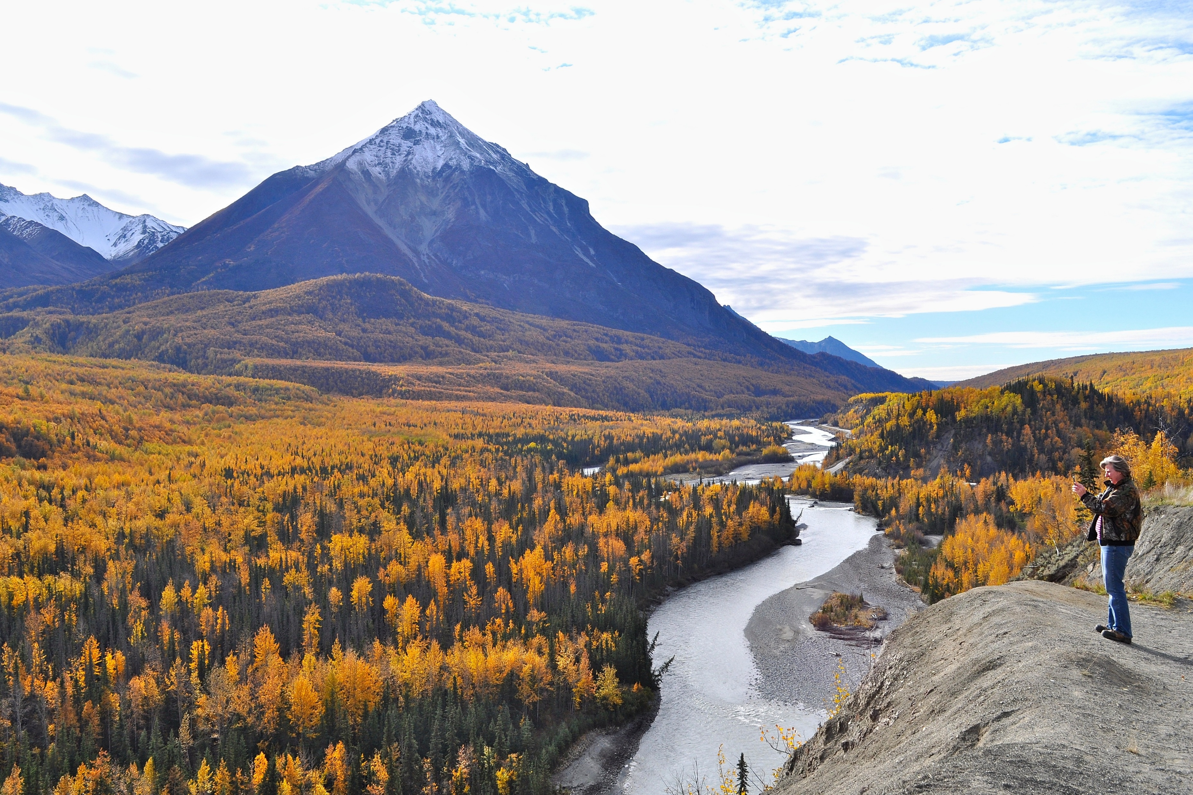
2- People have adapted to living in the tundra by wearing large thick coats called parkas with thick boots to keep warm in the tundra’s icy weather , along with hoods , hats , mitts , and other protaction .

Slide 5
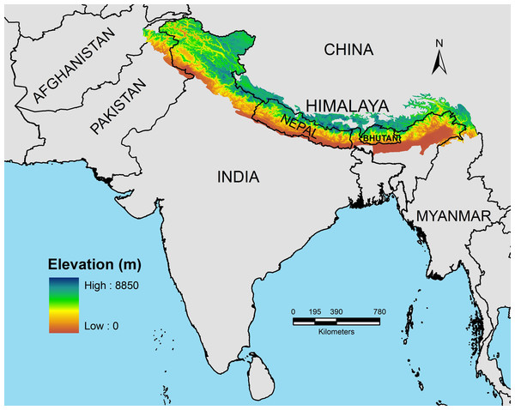
*Topographic Maps : according to the American heritage , the word “topography ’’ is defined as the surface features of a place or region .
A topographic map is a two-dimensional representation of a three dimensional land surface . It is also a summary of the landscape and show important physical (natural and man-made )features in an area .
These maps offer detail information on any particular area .
This Photo by Unknown Author is licensed under CC BY

Slide 6
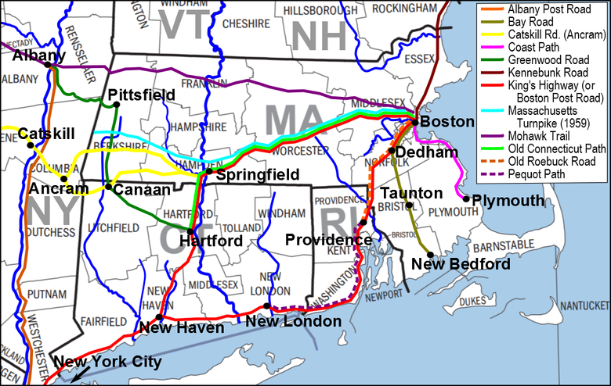
These maps portray different man-made features , for example :
This Photo by Unknown Author is licensed under CC BY-SA

Slide 7
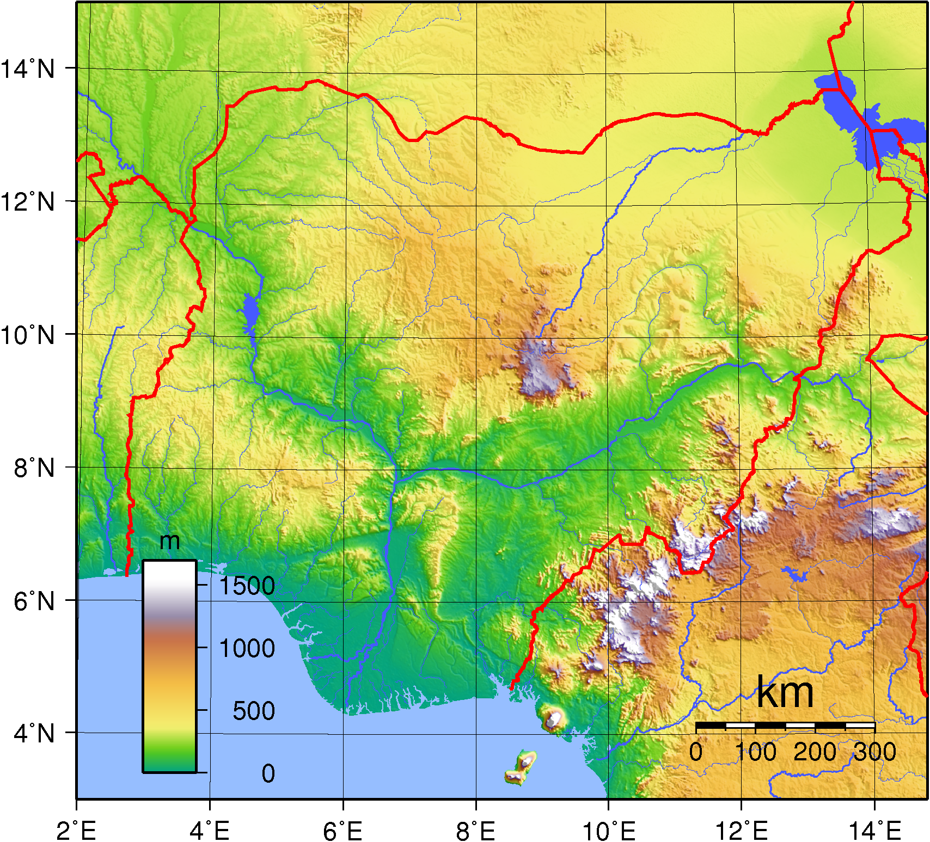
What are the characteristics of Topographic Maps ?
1- They show elevation using lines which join points of equal elevation above sea level .
This Photo by Unknown Author is licensed under CC BY-NC

Slide 8
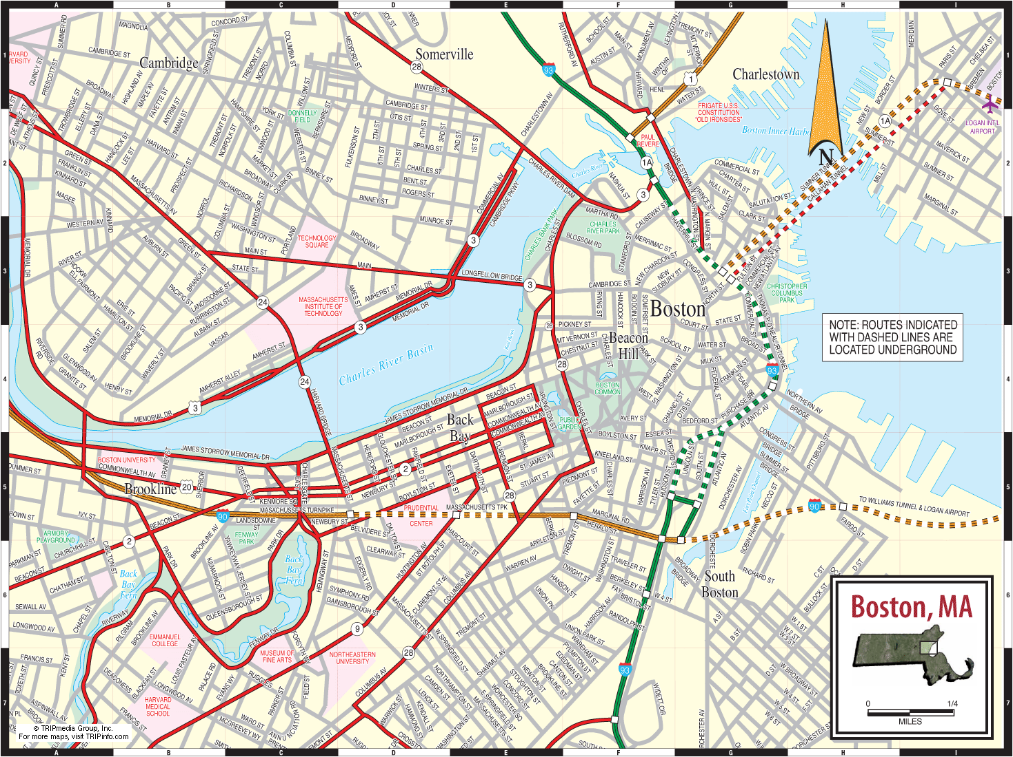
2- They have an emphasis on showing man-made features such as roads and cities , but also include thematic information such as vegetation or the boundaries of national parks .

Slide 9

3- They are typically produced by government agencies .

Slide 10
*Types of information you can find on a Topograhic Map :
1- Culture : roads , buildings , boundaries and railways .
2-Water : lakes , rivers , streams , swamps and rapids .
3-Relief : mountains , valleys , slopes .
4- Toponymy : names of places , names of water features and highway names .

Slide 11
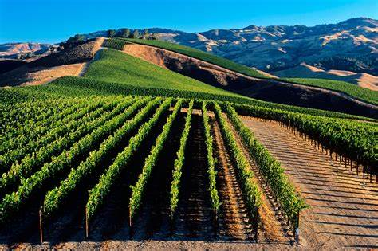
5-Vegetation : wooded and cleared areas , vineyards and orchards .

